Slide 1
XML Data
Semi structured Data
Dr. Shaheen Khatoon

Slide 2
Outline
Structured, Semistructured, and Unstructured Data
XML Hierarchical (Tree) Data Model
Extracting XML Documents from Relational Databases
XML Documents, DTD, and XML Schema
XML Languages

Slide 3
Structured, Semistructured, and Unstructured Data
Structured data
Represented in a strict format (schema)
Example: information stored in databases
Semi structured data
Has a certain structure
Not all information collected will have identical structure
Unstructured data
Limited indication of the of data document that contains information embedded within it

Slide 4
Examples
Structured: Excel spreadsheets Comma-separated value file (.csv) Relational database tables
Semi-structured: Hypertext Markup Language (HTML) files JavaScript Object Notation (JSON) files Extensible Markup Language (XML) files
Unstructured: Audio, Video, Flat Text

Slide 5
Semistructured Data
Schema information mixed in with data values
Self-describing data
May be displayed as a directed graph
Labels or tags on directed edges represent:
Schema names
Names of attributes
Object types (or entity types or classes)
Relationships

Slide 6
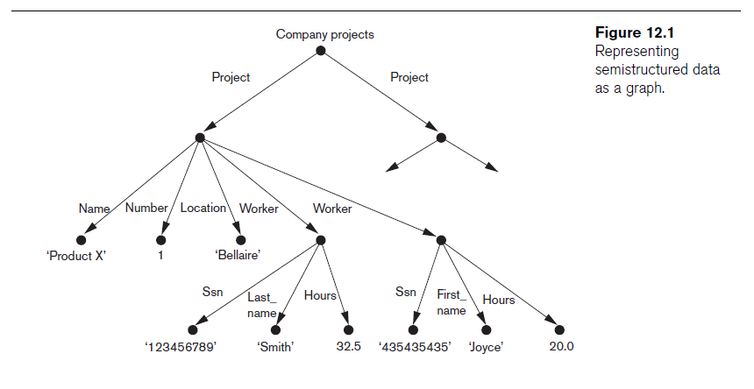
Semistructured Data (cont’d.)

Slide 7
XML: Extensible Markup Language
Data sources
Database storing data for Internet applications
Standard for data representation and exchange
Hypertext documents (HTML)
Common method of specifying contents and formatting of Web pages
Tags describe content instead of formatting
XML data model

Slide 8
XML Hierarchical (Tree) Data Model
Elements and attributes
Main structuring concepts used to construct an XML document
Complex elements
Constructed from other elements hierarchically
Simple elements
Contain data values
XML tag names
Describe the meaning of the data elements in the document
Start tag: angled brackets: <...>, end tag with a slash: </...>

Slide 9
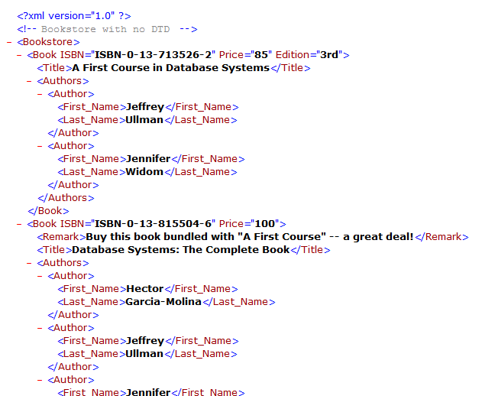
Well-Formed XML
Basic constructs
Tagged elements
(nested)
Attributes
Text
Simple element
Attributes
Complex element

Slide 10
Relational to XML Mapping

Slide 11
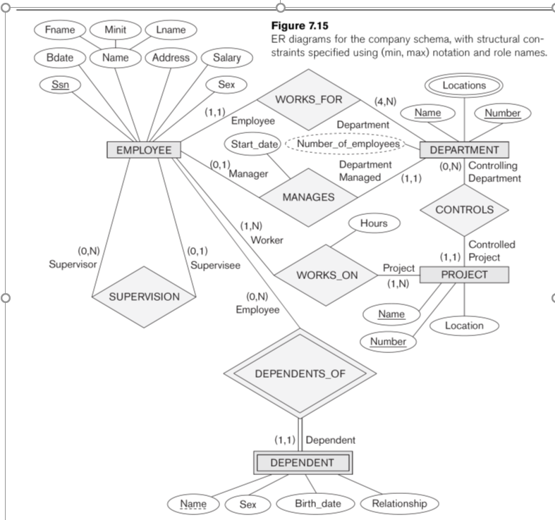
Company ER Model

Slide 12
Company Relational Model

Slide 13
Company Entities

Slide 14
Relational to XML Mapping
<?xml version="1.0" standalone="yes" ?>
<Departments>
<Department>
<Dname>Research</Dname>
<Dnumber>5</Dnumber>
<Mgr_ssn>333445555</Mgr_ssn>
<Mgr_start_date>1988-05-22</Mgr_start_date>
<Dlocation>Bellaire</Dlocation>
<Dlocation>Sugarland</Dlocation>
<Dlocation>Houston</Dlocation>
</Department>
<Department>
<Dname>Administration</Dname>
<Dnumber>4</Dnumber>
<Mgr_ssn>987654321</Mgr_ssn>
<Mgr_start_date>1995-01-01</Mgr_start_date>
<Dlocation>Stafford</Dlocation>
</Department>
...
</Departments>
Please complete mapping from the homework exercise

Slide 15
Relational Model versus XML
 | Relational | XML
Structure | Tables | Hierarchical Tree
Schema | Fixed in advance | Flexible “Self describing”
Queries | Simple (SQL) | Complex: Xpath, XQuery
Ordering | None – use order by clause | Implied ordering
Implementation | Native models of relational systems | Add-on

Slide 16
Knowledge Check
You're creating a database to contain information about university records: students, courses, grades, etc. Should you use the relational model or XML?
You're creating a database to contain information for a university web site: news, academic announcements, admissions, events, research, etc. Should you use the relational model or XML?
You're creating a database to contain information about family trees (ancestry). Should you use the relational model or XML?
Notes:
1- Relational model
2-XML
3- Either one is appropriate

Slide 17
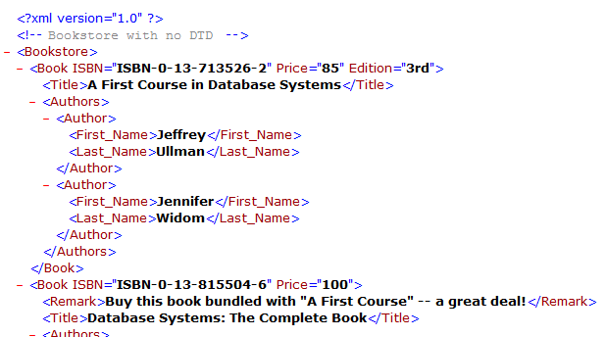
“Well-Formed” XML
Adheres to basic structural requirements
Single root element
Matched tags, proper nesting
Unique attributes within elements

Slide 18
“Well-Formed” XML
Adheres to basic structural requirements
Single root element
Matched tags, proper nesting
Unique attributes within elements
XML
Document
XML
Parser
Parsed XML
“Not well-formed”

Slide 19
Well-Formed XML
Displaying XML
Use rule-based language to translate to HTML
Cascading stylesheets (CSS)
Extensible stylesheet language (XSL)

Slide 20
Well-Formed XML
Displaying XML
Use rule-based language to translate to HTML
Cascading stylesheets (CSS)
Extensible stylesheet language (XSL)
Rules
XML
Document
(data)
HTML
Document
(look at)
CSS/XSL
interpreter

Slide 21
Well-Formed XML
Extensible Markup Language (XML)
Standard for data representation and exchange
Formal specification is enormous; we cover most important components

Slide 22
Practice: Identify Well Formed XML
<tasklist>
<task name="eat">
<task name="drink">
<task name="play"> </tasklist>
<tasklist>
<task name=eat/> <task name=drink/> <task name=play/> </tasklist>
<tasklist>
<task name="eat"/> <task name="drink"/>
<task name="play"/>
</tasklist>
<tasklist>
<task name="eat"/>
<task name="drink"/>
<task name="play"/> <tasklist>

Slide 23

XML Data
DTDs

Slide 24
“Well-Formed” XML
Adheres to basic structural requirements
Single root element
Matched tags, proper nesting
Unique attributes within elements

Slide 25
“Valid” XML
Adheres to basic structural requirements
Also adheres to content-specific specification
Document Type Descriptor (DTD)
XML Schema Description (XSD)

Slide 26
“Valid” XML
Adheres to basic structural requirements
Also adheres to content-specific specification
XML
Document
XML
Parser
Parsed XML
“Not well-formed”

Slide 27
“Valid” XML
Adheres to basic structural requirements
Also adheres to content-specific specification
DTD or XSD
XML
Document
Validating XML
Parser
Parsed XML
“Not valid”

Slide 28
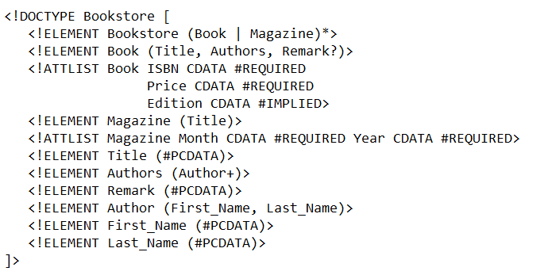
Document Type Descriptor (DTD)
Grammar-like language for specifying elements, attributes, nesting, ordering, #occurrences
Please refer to below link for more detail
w3schools.com/xml/xml_dtd_attributes.asp

Slide 29
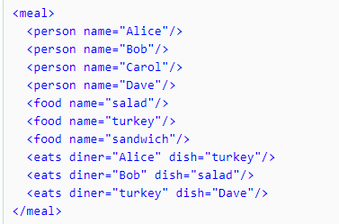
Here is an XML DTD
Create a XML documents that is valid with given DTD?
<!DOCTYPE meal
[ <!ELEMENT meal (person*,food*,eats*)> <!ELEMENT person EMPTY>
<!ELEMENT food EMPTY>
<!ELEMENT eats EMPTY>
<!ATTLIST person name ID #REQUIRED>
<!ATTLIST food name ID #REQUIRED>
<!ATTLIST eats diner IDREF #REQUIRED dish IDREF #REQUIRED> ]>

Slide 30
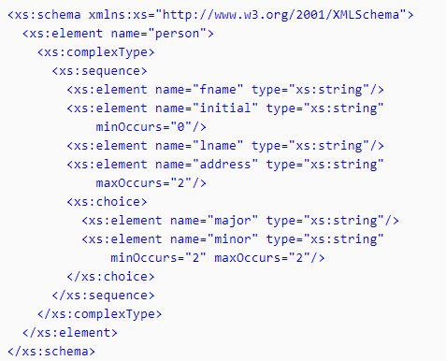
XML Schema (XSD)
Extensive language
Like DTDs, can specify elements, attributes,
nesting, ordering, #occurrences
Also data types, keys, (typed) pointers, and more
XSD is written in XML

Slide 31
DTD/XSD versus none (well-formed)
+ DTD/XSD Program can assume the structure CSS/XSL rules are simple when program has particular structure Specification language- DTD as a specification what the XML look like Documentation Strongly typed Data
DTD/XSD Flexibility and ease of change is difficult DTD can be messy- irregular structure Benefits of no typing

